Slide 1
Properties Files
Separating Settings From Application Logic

Slide 2
The Importance of System Settings
A system needs to know many details to provide its functionality:
How does the system access its information?
What credentials does it need to gain access?
Where does it find the information?
When implementing systems, we must consider how we provide these details
Why is this such an important aspect?
These are the system’s
configuration details!

Slide 3
How Does the Configuration Approach Impact the System?
A small implementation choice can make a system much easier to deploy and maintain.
Hardcoding locks details in
Change becomes costly
Tight coupling
We can store hard-coded config variables within our source code, such as:
Database URL
Username
Changing environments may require:
Code edits
System rebuilds
Another deployment!
Application logic becomes unnecessarily dependent on infrastructure details.
Tying the application to this specific infrastructure set up doesn’t make sense!
How can we break the link between the configuration details and the system’s logic??

Slide 4
Introducing java.util.Properties!
Properties.java : A built-in class for reading in (loading) and retrieving named configuration values.
Operates on key–value pairs
Load details from a file
Read by key
Example: url maps to a JDBC connection URL.
A .properties file keeps the settings outside the source code.
propertiesObj.getProperty("url")` retrieves the corresponding string value.
database.properties
Accessed in Java with:
driver=com.mysql.cj.jdbc.Driver
url=jdbc:mysql://127.0.0.1:3306/
database=classicmodels
username=root
Properties config = new Properties();
config.load(input);
String url = config.getProperty("url");
Note: properties files belong in /resources!

Slide 5
Where Do Properties Fit?
The configuration set up (.properties file + Properties object) supplies the required values
A connection component (Connector implementation) uses them
JDBC layer connects to the database.
Configuration file
Properties object
Connection layer
Database
database.properties
Reads from config file
Loads + retrieves details
Validates values from properties
Makes connections
Dev / test / prod
There are multiple possibilities!
Separation of concerns:
Keep the configuration loading in one place
Pass the resulting values to the component responsible for creating connections

Slide 6
Before vs After Configuration
Configuration: Move the environment-specific values out of our source code.
BEFORE • HARDCODED
AFTER • CONFIGURATION-DRIVEN
private String driver =
"com.mysql.cj.jdbc.Driver";
private String url =
"jdbc:mysql://127.0.0.1:3306/classicmodels";
private String username = "root";
private String password = "";
Connection connection =
DriverManager.getConnection(
url, user, password);
Properties config = new Properties();
config.load(input);
String url = config.getProperty("url");
String user = config.getProperty("username");
String password = “”;
Connection connection =
DriverManager.getConnection(
url, user, password);
Before: Settings are embedded in the code.
After: Settings are supplied at runtime.

Slide 7
What Improves
With a Configuration Approach?
Flexibility!
We can change database endpoints/addresses without changing the application code/logic
Portability
We can use the same code build in production, development and testing
Change the config details, keep the code identical
Maintainability
Keep configuration in a predictable, easy to find and reviewable place
Testability
Change config settings to test-specific values without amending the code/business logic

Slide 8
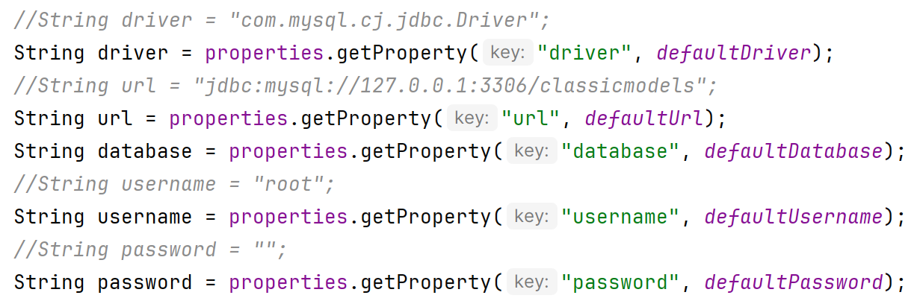
Plan for Failure:
The Value of Default Values
  What if a key is not found within a properties file?
    Can we provide a fallback?
  Properties class lets us specify default values
    Value to be used if the requested key cannot be retrieved
Source: week06_hashing/persistence/MySqlConnector.java

Slide 9
Locating Properties Files Within Spring:
Theory
  We work within a Spring project
    Spring’s project file path build is more complicated
  To ensure we can always find our properties files in resources/, we need to use relative file paths
    Access the currently executing thread (our application)
    Get the context for this thread
    Get the named resource from this context
  If this resource is not found, we’ll get an IOException
    Just like if we try to open a file that doesn’t exist!

Slide 10
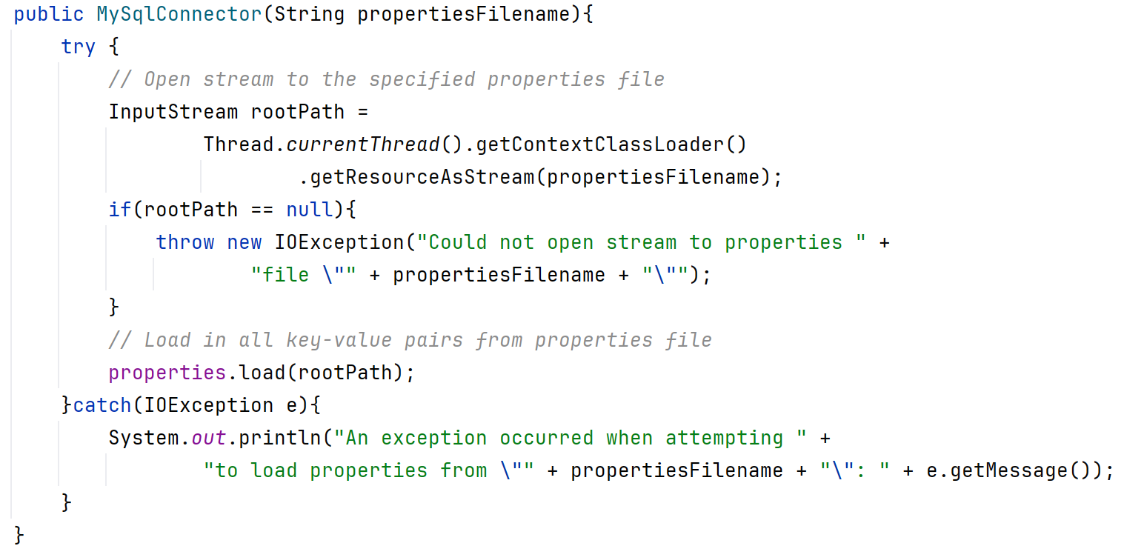
Locating Properties Files Within Spring: In Practice
Access the currently executing thread (our application)
Get the context for this thread
Get the named resource from this context
Load properties from resource (the .properties file)
Source: week06_hashing/persistence/MySqlConnector.java

